Slide 1
Conservation of Momentum

Slide 2
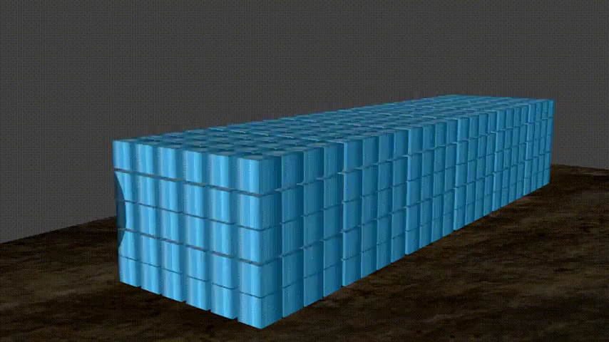
In this Smart Lesson you will learn to:
Recall the principle of conservation of momentum.
Solve problems involving momentum, impulse, the conservation of momentum and collisions in one dimension.

Slide 3
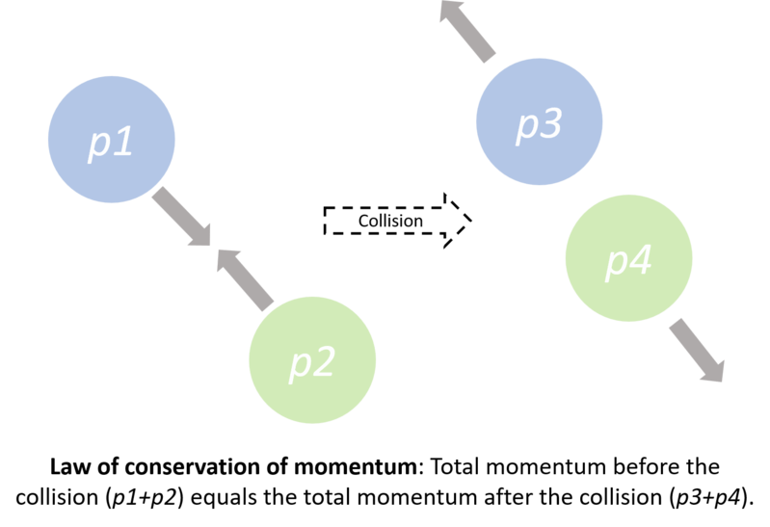
When an external force acts on an object, its momentum changes.
But when we consider multiple objects, with only internal forces between them, we find something interesting. The total momentum of those objects stays the same no matter what they do to each other. This is the idea of conservation.
Conservation of momentum tells us that the total momentum of a system, which could contain an infinite number of objects, is always the same, so long as there is no external force acting.

Slide 4
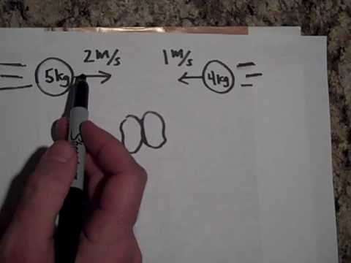

Slide 5
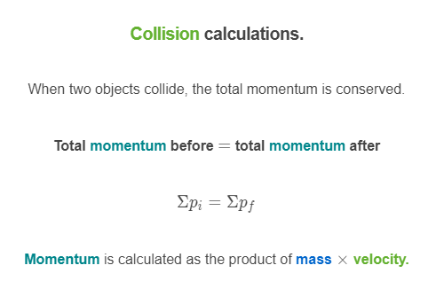


Slide 6
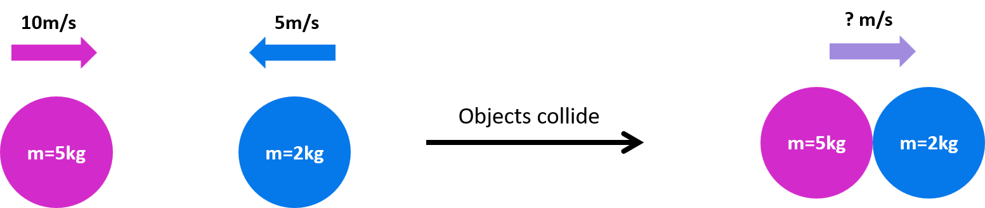
If momentum is conserved when two objects collide, it can be used to calculate the final velocity after a collision.
For example if two objects collide as shown below, then move together after the collision, you can calculate the final velocity.

Slide 7
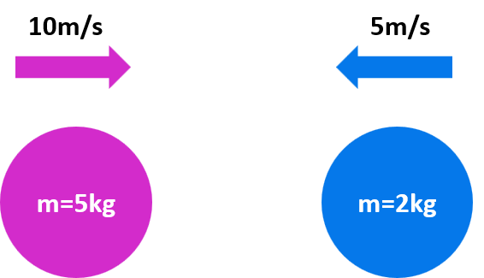
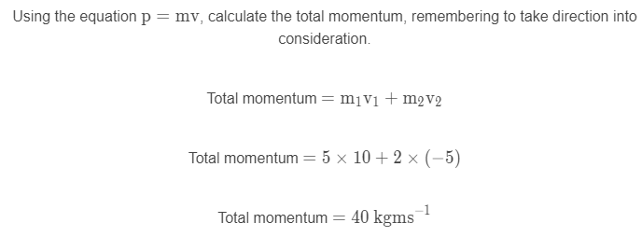
First calculate the total momentum before the collision:

Slide 8
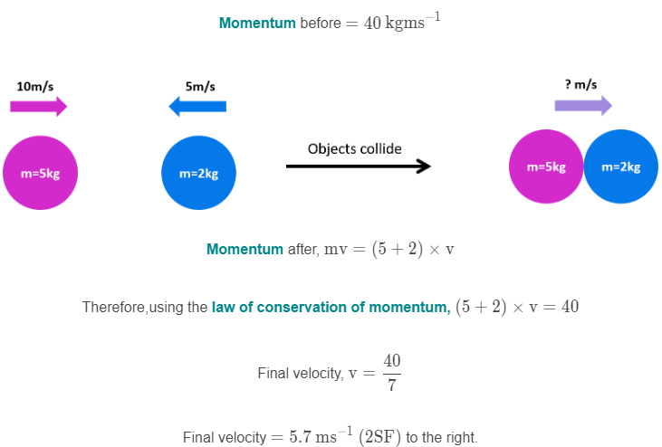
Assuming momentum is conserved, total momentum before must equal total momentum after a collision.

